Slide 1


National Technological University. General Pacheco Regional Faculty
How to install C++ In VSC?
Step-by-Step Guide to use C++ in
Visual Studio Code on windows
Subject: English
Students: Natalia Mucci
Miguel Angel Lardo
Date: July 1, 2025

Slide 2
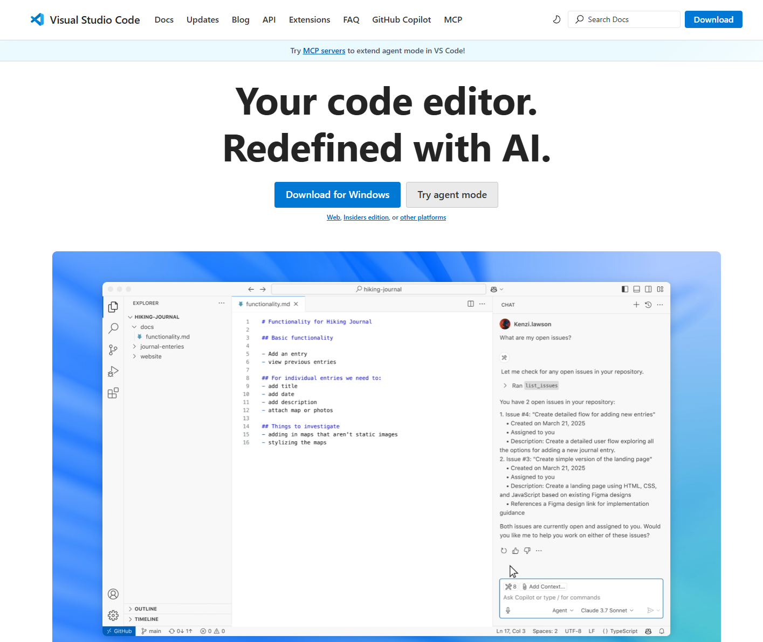
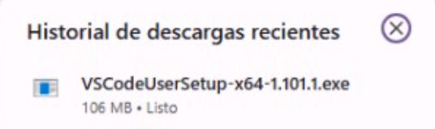
1. Install VSCODE
Go to the official web site https://code.visualstudio.com/ and click the “download” button
Run VSCodeUserSetup-x64-1.101.1.exe and Install with the default settings
Notes:
Install VS Code
Before installing, check if you already have VS Code.
If not: Go to the official website https://code.visualstudio.com/
and click the download button. Then, run VSCodeUserSetup-x64-1.101.1.exe
then Follow the steps (use default settings for easy setup).
2. Verify Installation After installation, open VS Code and check if it runs correctly. You can type Ctrl + N to create a new file and test basic features.

Slide 3
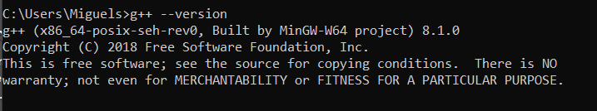
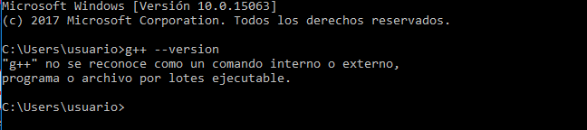
2. Check if C++ is already installed
Before installing, open a terminal (CMD, PowerShell) and type “g++ --version”
✅ If you see a version number e.g. 8.1.0→ go to step 9!
❌ If you get an error → You need to install a C++ compiler, go to step 3!

Slide 4


3. Go to the official website to Download Mingw-W64
Visit the official website : https://sourceforge.net/projects/mingw/, and click the “DOWNLOAD” button
4. Execute MinGW installer
Run mingw-get-setup.exe and follow the installation process

Slide 5
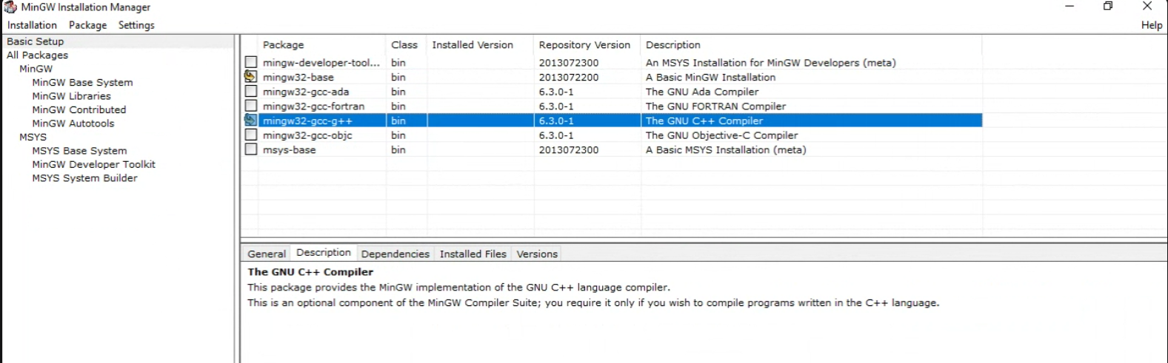
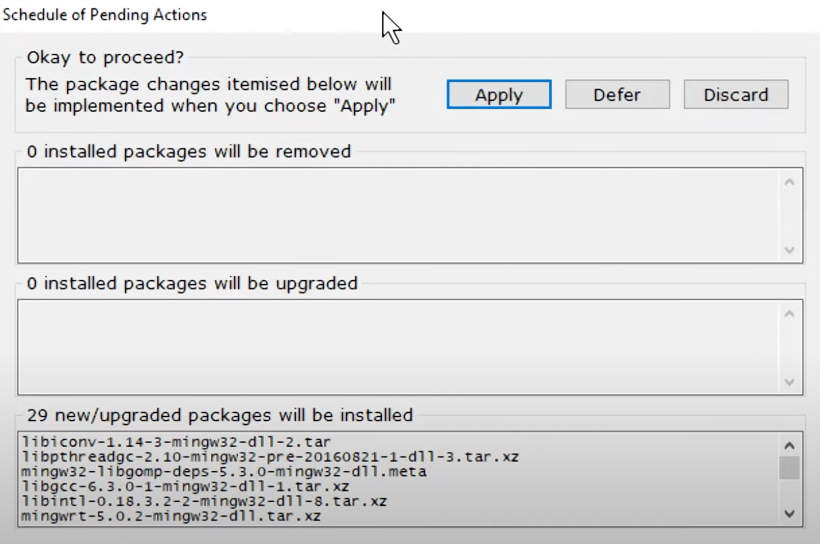
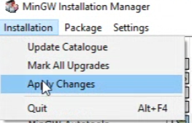
5. Select the packages
In the installer, select: mingw-32-base and mingw32-gcc-g++
Click "Installation" → "Apply Changes"

Slide 6
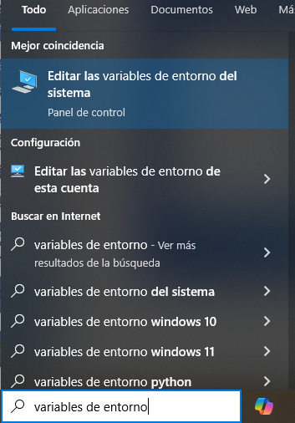
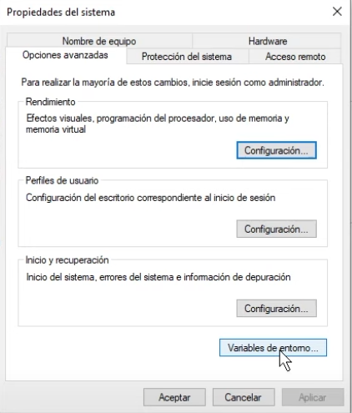
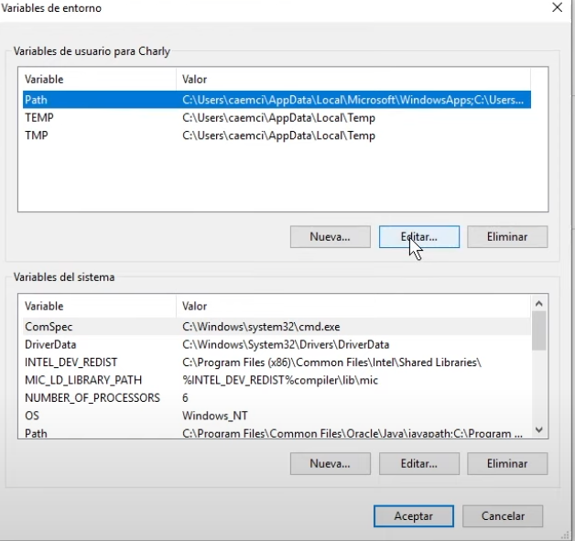
6. Add MinGW to system path variable
Open Environment Variables, select Path, and click Edit.

Slide 7
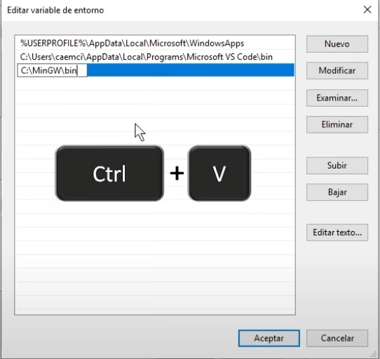
7. Copy and Paste the path where MinGW is installed
Locate MinGW’s bin folder (usually at C:\MinGW\bin). Click on the address bar and copy the full path (e.g. C:\MinGW\bin). Paste it into the Path variable.

Slide 8
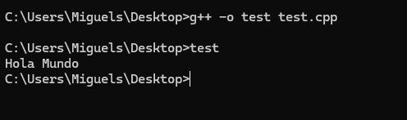
8. Verify if the installation was successful
Open a terminal (CMD or PowerShell) and run the command g++ --version again, to confirm that the installation was successful.

Slide 9
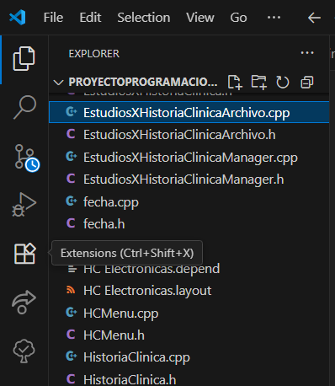
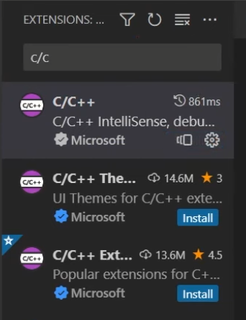
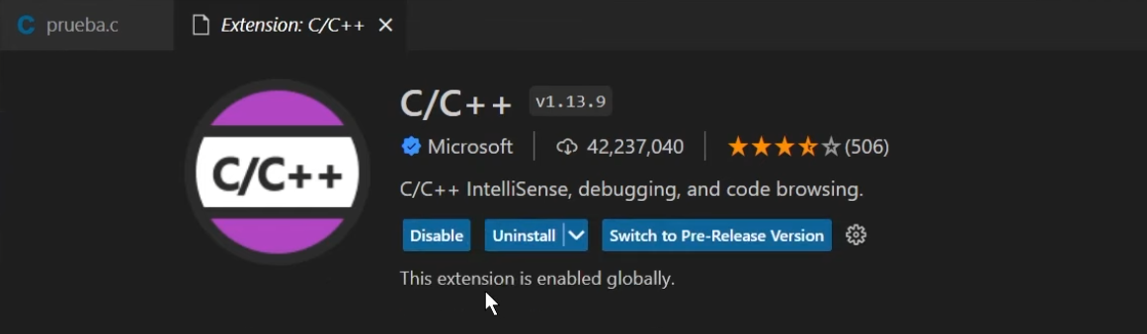
9. Install the C++ Extension in VS Code
On Vs Code, open the Extensions panel (Ctrl+Shift+X)
Search for C/C++ by Microsoft
Click “install”

